Slide 1




Joey Soccer 2022
Handbook for coaches

Slide 2
Introduction
This tool kit includes fun games that parents and coordinators can use to engage the children during the pre-game training session (15 minutes). In this handbook, you will find an assortment of exercise that we encourage all of you to choose and try with your Teams. Exercises 1-6 are suitable for all ages, whereas exercise 7-15 are less suitable for the majority of Kindy and Pre-Primary children.
We welcome all feedback and would love to hear about your experience with your Teams when using the various exercises. Please don’t hesitate to reach out as we have qualified coaching staff available to assist with any situation you may face in guiding and teaching your children.
Forward all questions and feedback to: joey@uwanfc.com.au
How do we coach
Kids just want to play games and have fun. Coaches want to ‘teach' them how to play. It is well documented that the best approach is to introduce a ball between 2 goals and to let them play. This form of play is called the street football approach to coaching children. If you don’t make it fun, they will lose interest and not want to play.
Drills are for older children as they introduce structure which at this young age can be viewed as boring, and players will lose interest.

Slide 3
Playing Tips
Tips
Coaches or game coordinators are an integral part of the experience. A coach must ensure a safe and positive environment for the enjoyment of all involved. So, what should we do to make the experience fun?
Keep rules few and simple. No hands, just kicking the ball, no holding or pushing just play the ball. Learn through trial and error.
Show them how they can score more if they pass.
Keep them coming back for more. Introduce some creative fun, like celebrate passing and scoring together.
Keep games small (5 a side) to keep the ball moving; this is the key.
Plenty of encouraging comments throughout the games.
In younger age groups keep play flowing even if the ball goes out a little. Kids this age do not even notice the lines.
Making it clear at the start and during the games where they need to score. Particularly younger kids just want to kick the ball into a goal. Guide them which is the right goal.
When children start to be disengaged break the game up into smaller groups to suit their enthusiasm. In doing this, you can have 2 games on 1 pitch, each group having a ball.

Slide 4
Exercise 1: The Boogeyman – duration 15 mins
Set up:
Create a square 20m x 20m
Create the white area for the Boogeyman (5m x 20m)
  This is where the defender seeks to win the ball
Create the blue ‘shooting area’ (5m x 20m)
  This is where the attackers shoot from
Description
Players start driving the balls and must get to the blue area, from which they need to shoot on goal. The defender (boogeyman) tries to take the ball away from team mates before they get to the blue area.
The boogeyman can’t leave his white area.

Slide 5
Exercise 2: Cops and Robbers – duration 15 mins
Set up:
Create a square 15m x 15m
In the centre of the square, create another square 3m x 3m.
Give a vest to the defender; he will be placed on guard
The other players go outside the big square
Place 6 balls in the central square
Description
On the coach’s signal players, try to conquer the balls that are inside the square; once they conquer the ball, they should take it to the base (outside of the square) while the defender tries to touch the forwards in order to make them go back to the starting point without the ball
Coaching points
Keep the ball close to the foot when running with the ball
Be on top of the ball by keeping the upper body slightly bent forwards
Control the situation by developing peripheral vision
Ease the success of the exercise by allowing them to drive the ball with their preferred foot

Slide 6
Exercise 3: Catch the fugitives – duration 15 mins
Set up:
Create a square 15m x 15m
Give a vest to the defender
Players go inside the square
The defender starts with the ball in his hands
Description
Players try to run away from the defender that tries to hit them with the ball
Rules
Players that are hit become defenders
The winner will be the last player that gets hit
Coaching points
Players have to execute changes in direction based on the positioning of the rival, with the ball in their hands and paying attention to their movements
Changes in direction are executed with the proper coordination to avoid the attack of the rival both quickly and efficiently
Ease the success of the exercise by introducing a second ball
Variations
The coach can choose if the ball is driven with the feet
The coach can make fugitives drive the ball

Slide 7
Exercise 4: The Boogeyman– duration 15 mins
Set up:
Create a square 15m x 15m and divide it into two equally sized parts
A player starts with the vest in the lines that divides the square, while the others start from the side.
Description
The player with the vest has to touch his teammate before they get to the line that divides the square. If teammates are touched, they become ‘boogeymen’ and can start touching opponents
Rules
The boogeymen can only move in front of the dividing middle line
The player that is touched last will be the winner
Coaching points
Players that participate in the exercise have to understand the position of the opponent in order for them to avoid being touched.
Players with vest simulate pressing action when following rivals
Adapt the dimensions of the playing area based on skills
Variations
The coach can make those teammates that are touched move only if they are holding hands.

Slide 8
Exercise 5: Mine Field – duration 15 mins
Set up:
Create a 20x15m rectangle. Create the first line with markers at 5m. Create the blue end zone (4mx15m). Use cones or a small goal to create a target for players to shoot on at the right-hand side of the blue zone. The group is divided into two teams as per set up, all with balls.
Description
Half the group of players start driving the ball and must get to the end zone from which they shoot on a target. Players on the outside try to hit the runners or their balls, after which they have to return to the starting point. Runners can’t be hit until they pass the first line (at 5m). At the end of each series, swap positions
Coaching points
In case of large groups create two playing areas to avoid long waiting times
Keep the ball close to the foot
Try using both feet
Try to execute safe impacts of the ball
Be on top of the ball by keeping the upper body slightly bend forwards
Use your peripheral vision to avoid being hit by a ball.
Rules
Each goal is worth 1 point
If the runners are hit on the feet or ball, they will have to go back and start over
The winning team will be the one that scores the most points

Slide 9
Exercise 6: Run through the gate – duration 15 mins
Set up:
Create a square of 15m x 15m with space markers. Make four goals of about 2 metres in each of the corners of the square. Divide the team into 2 groups of four players. Players place themselves freely in the square; each player has a ball. One team plays with feet while the other plays with the hands.
Description
Players move freely inside the square. Attacking players drive the ball with their feet while defending players play with their hands. On the coach signal, attacking players will drive the ball through the goals avoiding their ball gets hit by the ball thrown by the defender.
Coaching points
Keep the ball close to the foot
Try using both feet
Try to execute safe impacts of the ball
Be on top of the ball by keeping the upper body slightly bend forwards
Players must keep their head up, trying to decrease eye contact with the ball but still keeping it under control
Touch the ball with the outside of the foot, using inside only for changes in direction
Rules
If the ball of the defender hits the ball off the attacking player, the attacking player must stop and cannot try to score anymore
Each ball driven inside the goals is worth one point
The winning team is the one that scores the most points

Slide 10
Exercise 7: duration 8-10 mins
Objective
Ball mastery, running with the ball and reaction speed
Description
Mark out a square appropriate for the level of the players. Position lines of 4 cones and a small pole gate (or mini-goals) in each corner. For this practice, two players are waiting by the central cone with a ball. They wait for the coach to call out 2 colours.
As soon as the coach calls out 2 colours (e.g. ‘yellow or blue’), the players must dribble the ball towards the corner of one of those colours, slalom through the 4 cones and then pass the ball in between the poles (or mini-goals) to score.
Only the player that scores first gets a point.
Variations
Call out 1 colour, and the players compete to try and score in the same goal
Have 4 players and call out 2 colours
Have 4 players who race to complete all 4 corners consecutively

Slide 11
Exercise 8: duration 8-10 mins
Objective
Dribbling against a front-on defender with changes of direction and different techniques.
Description
In a 10 x 20m area, mark two end zones and a cone gate in the centre which is defended by 1 player. On each side, there are 2 or more players with a ball.
The aim is to run with the ball from one end zone to the other by using a move to beat a defender and dribble through the central cone gate.
The players continue to go from one end to the other through the cone gat if the defender wins the balls or kicks the ball out of the area, he switches roles with the player who lost the ball.
Progressions
Reduce the size of the cone gate to increase the difficulty
Add a second defender to trying to win the ball
Perform all dribbling moves with the weaker foot.

Slide 12
Exercise 9: duration 8-10 mins
Objective
Accurate dribbling moves with the weaker foot.
Description
In a 20m square, have an even number of players and several cone gates (adjust the size-dependent on player numbers). The group splits in a defending team (red) and an attacking team (white). The red players start with a ball, and the white players defend the cone gates.
The aim is to approach a defender and dribble past them, then dribble through a cone gate. Each time this happens, they score 1 point for their team.
If a defender wins the ball, they score 1 point and switch roles with the attacking player.
Variations
Perform all dribbling moves with the weaker foot.
The players who are defending must do so with their legs together. This makes it easier for the attacking players.

Slide 13
Exercise 10: duration 10 mins
Objective
To practice fast 3v2 (2v2+1) duels.
Description
Within a 10x15m area, there are 2 teams with 2 players + 1 yellow neutral player. There are 2 small goals at each end.
The exercise starts with the coach, who passes to one of the players. In the diagram example, the red players attack with the neutral player (3v2) and try to score in the 2 small goals at the far end.
The blue players defend and try to win the ball. When an attack is finished, the ball goes out of play, or the blues win the ball, the coach passes a new ball to a blue player, and they launch a 3v2 attack with the neutral players towards the opposite end.
Variations
Add a halfway line (red dashed line in the diagram). In order for the goal to be valid, all 3 players must be in the attacking half before a goal can be scored.
Both teams can score in any of the 4 goals

Slide 14
Exercise 11: duration 8-10 mins
Objective
Passing and receiving in pairs to beat opponents.
Description
Mark out a 20x30m square. In the example, there are 7 pairs (a total of 14 players).
The red attacking pairs (each with a ball) pass to each other and try to keep possession. The white defending pairs hold hands and try to win the ball.
If a defending pair win the ball, they switch roles with the attacking pair that they won the ball from.
Run the practice for 1 minute. When the minute is over, the pairs that have possession of a ball win a point. Repeat this one-minute game until a pair reaches 3 points.
Progressions
Limit the players to 2/3 touches
The defending pair do not have to hold hands

Slide 15
Exercise 12: duration 6-8 mins
Objective
Passing and receiving in pairs to beat opponents.
Description
Mark out an area to suit the age/level of the players. Position 6 large cone gates (5m) as shown.
There are 3 teams with each 4 players – 2 players defend cone gates, and the other pair pass the ball around the circuit (clockwise or anti-clockwise).
One player must pass through the cone gate for the other to receive – this can be done with 1 pass or a one-two combination. Each time this is achieved, that team scores 1 point.
If a defender wins the ball or kicks it out of play (1 point), he and the other defender of the same colour become an attacking pair – the pair that were in possession move to defend the cone gates
Progressions
On the coach’s whistle, all pairs change direction
The defending pair do not have to hold hands

Slide 16
Exercise 13: duration 8-10 mins
Objective
Running with the ball, stopping the ball (control) and shooting.
Description
In an area of 20m x 20m, 2 goals are placed on the pitch connected by 2 ‘rivers’. The player must run with the ball inside the river, pretending to be in a canoe. Without going outside of the river, they must stop the ball and shoot in the goal.
After the shot, the player picks up the ball out of the goal and start dribbling the ball along the other river towards the other goal.
Variations
Shooting without stopping the ball
Set obstacles to be avoided inside the rivers
Coaching points
Players need to keep the ball close to their feet, especially around turns
When shooting, the head should be over the ball, and the non-striking foot should be placed next to the ball to maximise accuracy

Slide 17
Exercise 14: duration 10-12 mins
Objective
Ball control/mastery and dribbling at speed. Running, coordination, adapting and motor reactions.
Description
The players dribble the ball in an area of 12 yards x 12 yards. On the outside, there are 4 coloured zones. The coach calls out a colour, and all the players must quickly run towards the coloured zone called out by the coach. The last player to arrive in the zone will be subject to a penalty or lose a point.
Variations
Associate the colour to an object or image, such as ‘let’s go to the sea’ (blue)
Coaching points
When dribbling within the square, players need to use small touches (keeping the ball close to their feet) and have a good concentration/awareness to avoid collisions
Make sure the players react quickly to your call, encouraging them to dribble quickly to the correct coloured zone

Slide 18
Exercise 15: duration 10-12 mins
Objective
Running with the ball
Description
In an area of 20m x 20m, a holding square is marked out where the balls are placed. Two lines of cones are marked out (3 or 4) through which the players need to dribble. Two teams are made with one player from each team collecting a ball on the coaches signal, and dribbling it through the cones. The player to first cross the line (ball and player) wins a point.
Variations
Using your weak foot
Place a target for the players to hit after their dribble
  Goal
  Ball placed on a cone

Slide 19
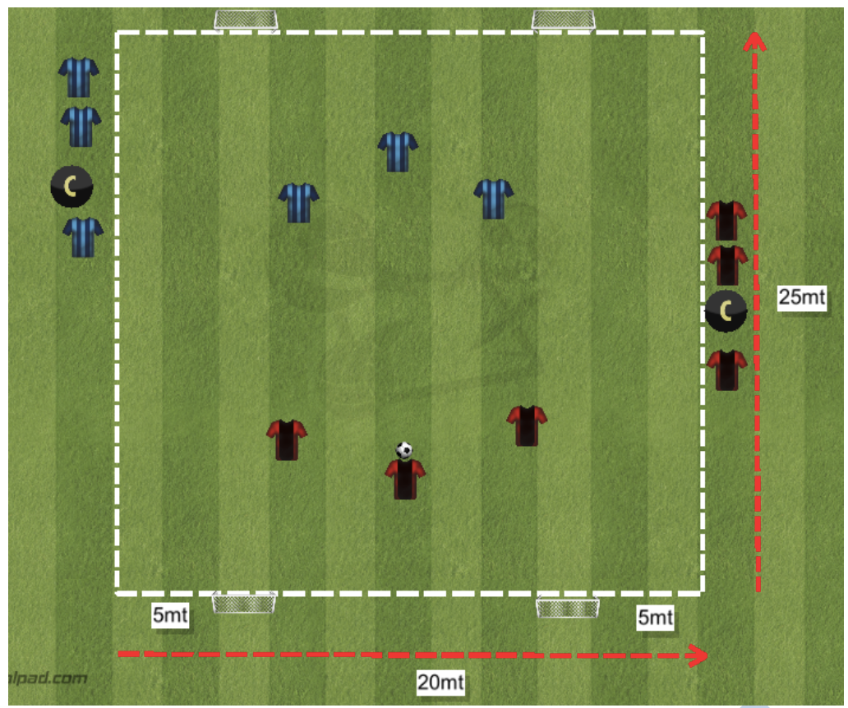
Mini Soccer
Mini Soccer 3v3
4 goals
Three halves of 10 minutes
Rotation of the kids every 2/3 minutes

